Slide 1
EETS 8355: data center network engineering
Dr. M. Scott Kingsley
NETWORK DISAGGREGATION

Slide 2
Network Disaggregation
Network Disaggregation defines the evolution of switching and routing appliances from proprietary, closed hardware and software sourced from a single vendor, towards totally decoupled, open components which are combined to form a complete switching and routing device.

Slide 3
AT&T Network Transformation
Network growth necessitates economies of scale that can only be achieved from interoperability and open disaggregation.
The open dNOS, like AT&T’s Vyatta NOS, that’s disaggregated from the underlying hardware (chassis, controller, line cards, etc.).
Well-defined standard interfaces and APIs enabling modularity with the ability to mix and match applications.
Independent scaling of control and user/data plane functions to drive an open ecosystem.
AT&T is leading efforts in industry bodies like the Open Compute Project (OCP), Open Networking Foundation (ONF), Open-RAN (O-RAN), OpenROADM, and the Linux Foundation to commoditize interoperable network functions and compute modularity without being cost prohibitive.
https://about.att.com/content/dam/snrdocs/7_Tenets_of_ATTs_Network_Transformation_White_Paper.pdf

Slide 4
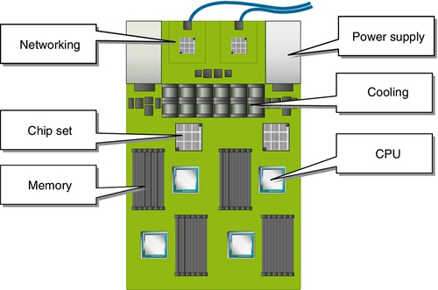
Traditional server components

Slide 5
Disaggregation
Silicon
Operating system
Original Device Manufacturers (ODM’s)
White vs. Grey vs. Brite boxes
Routing stacks
Standards and foundations

Slide 6
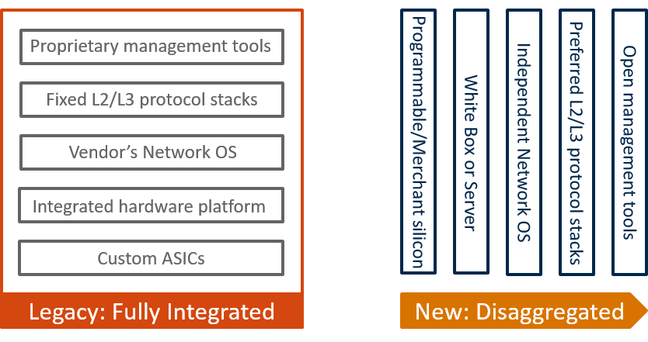
Disaggregation

Slide 7
Silicon
Data center operators want larger port count switches to build large networks they also want smaller port count switches for each leaf.
Silicon vendors provide two (or more) variations: one for spines and one for leafs.
Cisco, Juniper
“Merchant” silicon
Broadcom Trident and Tomahawk
Programmable chipsets

Slide 8
Silicon
Throughput
12.8 Tbps
25.6 Tbps
Port speed examples
48 x 1/10/25 GbE
32 x 400 GbE
64 x 200 GbE
16 x 100 GbE
64 x 100 GbE

Slide 9


Slide 10
Silicon
AMD
Intel
NVIDIA
ARM
AWS
Google
Microsoft
Broadcom
Barefoot
Innovium

Slide 11
Network Operating Systems
Cumulus Networks Linux
Big Switch Switch Light
Open Network Linux
Dell Systems FTOS
IPinFusion OcNos
Coriant NOS
Arista Networks EOS
Facebook FBOSS
Microsoft Cloud SONIC (Azure Cloud Switch)
VYOS (formerly Vyatta)
ONOS
More……

Slide 12

Rise of the ODM’s

Slide 13
End of lecture 2

Slide 14
NVIDIA
The Data Center is the New Unit of Computing (NVIDIA GTC 2021 Keynote Part 3) – YouTube

Slide 15
ODM’s
DNI
Supermicro
Edgecore
Quanta
Celestica

Slide 16
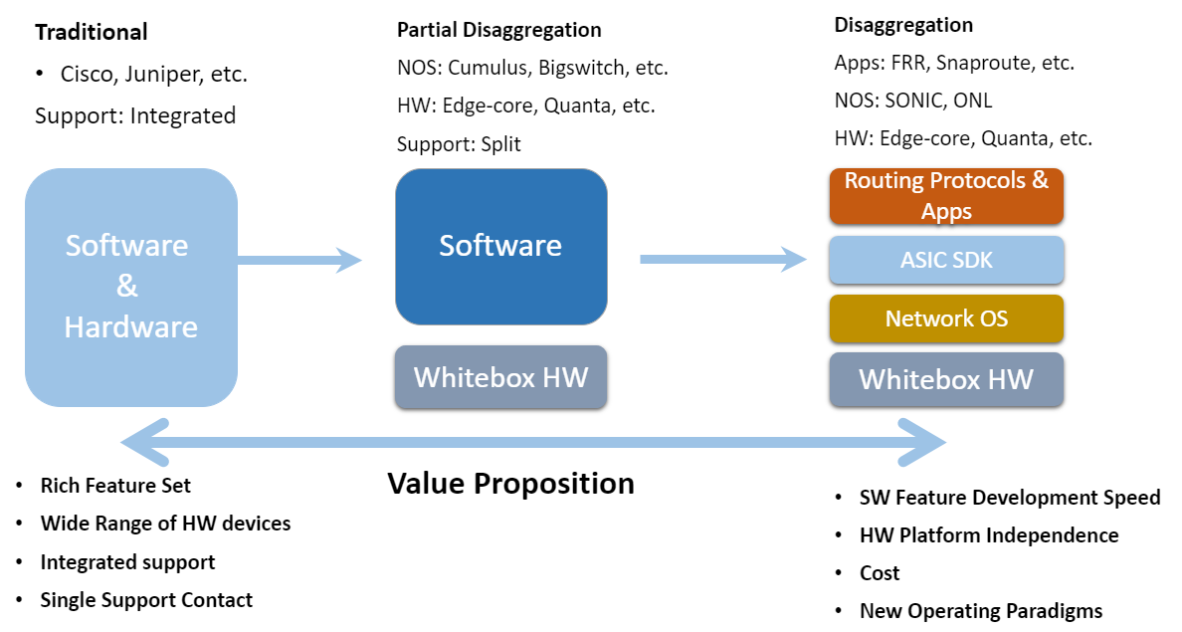
White box versus Brite box

Slide 17
White box versus Brite box
White box switch
White box switch is a by-product of SDN, which decouples the hardware (a bare metal switch) from the NOS.
It allows customers to buy open switch hardware and pair it with their preferred networking operating system (NOS) like Cumulus Linux or PicOS. Customers can buy white box switch from hardware suppliers like Accton, Quanta.
Brite box switch
The term “brite box” is a white box switch but with a brand name such as Dell and HP on them.
A brite box switch is the middle ground between a traditional switch and white box switch.
Brite box switches are pre-loaded with a vendor’s (e.g. Cumulus Networks or Big Switch Networks) operating system.
Thus, using brite box switch, customers can receive professional service from the hardware and software suppliers.
As an open source switch, it allows customers to have the flexibility to choose the switch software.

Slide 18
Empire Strikes Back
Cisco ACI
Intent-based networking

Slide 19
Standards and foundations
Open Compute Project
Open Network Foundation (Openflow and SDN)
Linux Foundation
IETF
IEEE

Slide 20
Routing stacks
Every vendor has at least one
Feature rich
High performance
Proprietary
Reasons for using something else:
Vertical integration with some operating system
Customization or tuning to fit needs

Slide 21
Routing Stacks: FRRouting
FRRouting (FRR) is a free and open source Internet routing protocol suite for Linux and Unix platforms.
It implements BGP, OSPF, RIP, IS-IS, PIM, LDP, BFD, Babel, PBR, OpenFabric and VRRP, with alpha support for EIGRP and NHRP.
FRR’s seamless integration with native Linux/Unix IP networking stacks makes it a general purpose routing stack applicable to a wide variety of use cases including connecting hosts/VMs/containers to the network, advertising network services, LAN switching and routing, Internet access routers, and Internet peering.

Slide 22
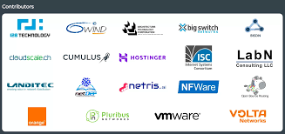
FRRouting

Slide 23
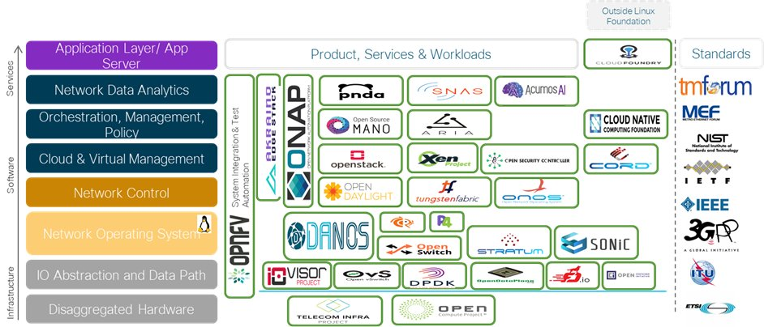
Disaggregation participants

Slide 24
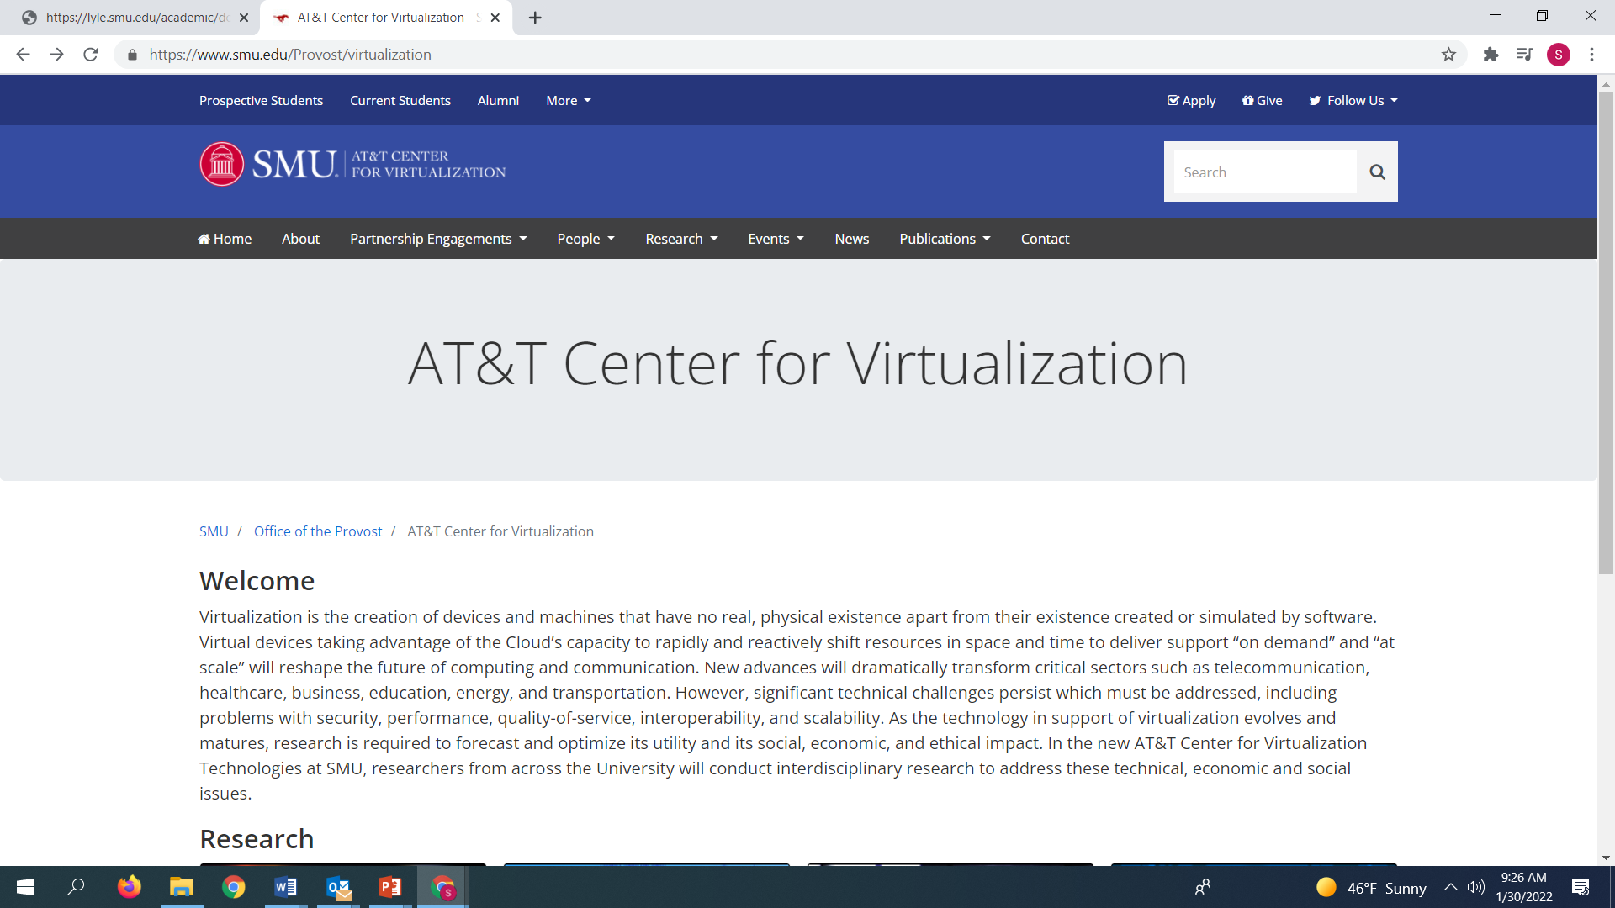
SMU/AT&T Virtualization Center

Slide 25
YouTube
Facebook's Data Center Fabric
www.youtube.com/watch?v=kcI3fGEait0&t=1888s
https://www.youtube.com/watch?v=KKIVEj-YbiU&t=682s
Google data center
https://www.youtube.com/watch?v=pIZXvVl8vIM
https://www.youtube.com/watch?v=7ygRSyeizPw&t=492s
https://www.youtube.com/watch?v=eE-8VXB1xUo&t=1648s

Slide 26
YouTube
The link below goes with the linear programming lecture:
Moving Fast with Facebook's New Long-Haul Network - Facebook - Network@Scale2017
https://www.youtube.com/watch?v=PeqaVCDRDY4

Slide 27
YouTube
GOOGLE DATA CENTER 2021
https://www.youtube.com/watch?v=kythGOICErQ

